Slide 1
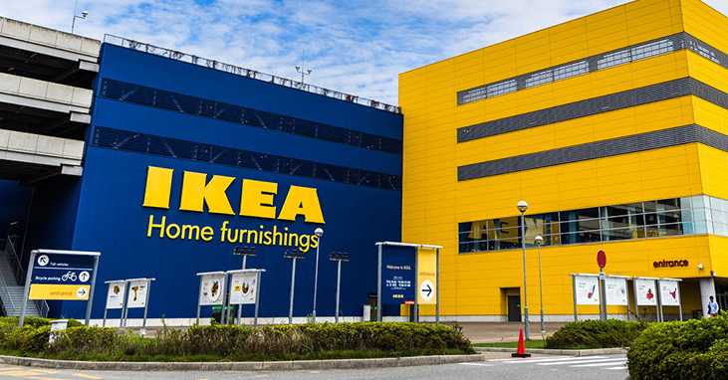

Slide 2

Company Background
Ingvar Kamprad
founded in 1943.
Sweden Based
designs and sells ready-to-assemble furniture, kitchen appliances, home accessories and occasionally home services
known for its modernist designs and its interior design work is often associated with an eco-friendly simplicity.

Slide 3
Need for Innovation
To stay competitive
Increase Revenue
Losing market share in Italy
New technology crashing into the marketplace
Provide incentives for the customer to come to physical stores as opposed to online shopping.
Unique Physical Experiences for the pop-up store.

Slide 4
Main Innovation - Enhanced Digital Offerings
IKEA augmented reality Place app - allows customers to to figure out if a piece of furniture will look good in your home.
Downloaded over 2 million times and been widely used
Change in the DIY assembly for customers
IKEA acquired TaskRabbit, a platform that allows customers to connect to individuals who assemble IKEA furniture -- gave customers a way to avoid the DIY trauma
TaskRabbit lets people pick up odd jobs and tasks on-demand–to make it frictionless for Ikea customers to hire someone to purchase and assemble their furniture for them.
Notes:
https://www.forbes.com/sites/bernardmarr/2018/10/19/the-amazing-digital-transformation-of-ikea-virtual-reality-apps-self-driving-cars/#2181d3a276be Digital technologies are expected to allow IKEA to reach more customers in a more cost-effective way than building new stores and paying high real estate prices.

Slide 5
Main Innovation Implemented
Services:
“You shop online, we prepare the order and deliver it to you”
Proximity:
More accessible
Entertainment:
Customize product
Dynamic displaying product: on screen, physical display, projection
Local neighborhood style
Notes:
Customers shopping online, the company shipping the good to their home

Slide 6
Alignment to business model
Category | Old | New
What? Value Proposition | Attracts customers with products of good design function and low price | Secure continuous improvement, development, expansion and a long life of the IKEA Concept (starts with the idea of providing a range of home furnishing products that are affordable to the many people, not just the few.)
Who? Customer Segment | Customers and factories | Consumers who love ideas based on hidden and limited space Middle/lower class population All age groups New home buyers/families Students Consumers who love innovative designs Consumers who love functional designs

Slide 7
Alignment to business model
Category | Old | New
How? Business Process | Scandinavia Retail shops | World-wide Retail shops and Online Shop
Value? Revenue Model | Attract customers with products of good design, function and low price Focused on attracting factories with large orders, which meant lower purchasing prices → more customer and higher sales volume | consists of three core businesses – franchising, range and supply and industry. Reduced labour cost via mass production Inter IKEA Investments AB opens an office in Stockholm with a focus on investments in non-listed Swedish companies

Slide 8
Impact of innovation
Services
Social Change; Customers no longer find the need to go to the shop physically to see the furniture but instead they are able to buy furniture at their convenience.
Digital technologies are expected to allow IKEA to reach more customers in a more cost-effective way than building new stores and paying high real estate prices
Proximity
Customers are no longer restricted by physical store location
Entertainment
Customers able to undergo a unique experience that will not be seen anywhere else.

Slide 9
Innovation Challenges
The physical stores only reaches a certain amount of audience limited by geographical area.
Not highly impactful as display items do not directly translate into sales.
When retailers cut out too much of their selection, they can compromise their brand identity.
Notes:
https://www.forbes.com/sites/bernardmarr/2018/10/19/the-amazing-digital-transformation-of-ikea-virtual-reality-apps-self-driving-cars/#2181d3a276be
https://edition.cnn.com/2018/12/03/business/ikea-new-york-retail/index.html
Erm, no matter how much they push for online shopping, the very nature of IKEA (furniture shopping) will impede shopper’s decision to buy online as they would instinctively wish to be able to see the items in person.

